Slide 1
The String Class
Constructing a String:
String message = "Welcome to Java“;
String message = new String("Welcome to Java“);
String s = new String();
Obtaining String length and Retrieving Individual Characters in a string
String Concatenation (concat)
Substrings (substring(index), substring(start, end))
Comparisons (equals, compareTo)
String Conversions
Finding a Character or a Substring in a String
Conversions between Strings and Arrays
Converting Characters and Numeric Values to Strings

Slide 2
Constructing Strings
String newString = new String(stringLiteral);
String message = new String("Welcome to Java");
Since strings are used frequently, Java provides a shorthand initializer for creating a string:
String message = "Welcome to Java";

Slide 3
Strings Are Immutable
A String object is immutable; its contents cannot be changed. Does the following code change the contents of the string?
String s = "Java";
s = "HTML";

Slide 4
Trace Code
animation
String s = "Java";
s = "HTML";

Slide 5
Trace Code
animation
String s = "Java";
s = "HTML";

Slide 6
Interned Strings
Since strings are immutable and are frequently used, to improve efficiency and save memory, the JVM uses a unique instance for string literals with the same character sequence. Such an instance is called interned. For example, the following statements:

Slide 7
Examples
display
s1 == s is false
s1 == s3 is true
A new object is created if you use the new operator.
If you use the string initializer, no new object is created if the interned object is already created.

Slide 8
Trace Code
animation

Slide 9
Trace Code

Slide 10
Trace Code

Slide 11
Replacing and Splitting Strings

Slide 12
Examples
"Welcome".replace('e', 'A') returns a new string, WAlcomA.
"Welcome".replaceFirst("e", "AB") returns a new string, WABlcome.
"Welcome".replace("e", "AB") returns a new string, WABlcomAB.
"Welcome".replace("el", "AB") returns a new string, WABcome.

Slide 13
Splitting a String
String[] tokens = "Java#HTML#Perl".split("#", 0);
for (int i = 0; i < tokens.length; i++)
System.out.print(tokens[i] + " ");
displays
Java HTML Perl

Slide 14
Matching, Replacing and Splitting by Patterns
You can match, replace, or split a string by specifying a pattern. This is an extremely useful and powerful feature, commonly known as regular expression. Regular expression is complex to beginning students. For this reason, two simple patterns are used in this section. Please refer to Supplement III.F, “Regular Expressions,” for further studies.
"Java".matches("Java");
"Java".equals("Java");
"Java is fun".matches("Java.*");
"Java is cool".matches("Java.*");

Slide 15
Matching, Replacing and Splitting by Patterns
The replaceAll, replaceFirst, and split methods can be used with a regular expression. For example, the following statement returns a new string that replaces $, +, or # in "a+b$#c" by the string NNN.
String s = "a+b$#c".replaceAll("[$+#]", "NNN");
System.out.println(s);
Here the regular expression [$+#] specifies a pattern that matches $, +, or #. So, the output is aNNNbNNNNNNc.

Slide 16
Matching, Replacing and Splitting by Patterns
The following statement splits the string into an array of strings delimited by some punctuation marks.
String[] tokens = "Java,C?C#,C++".split("[.,:;?]");
for (int i = 0; i < tokens.length; i++)
System.out.println(tokens[i]);

Slide 17
Convert Character and Numbers to Strings
The String class provides several static valueOf methods for converting a character, an array of characters, and numeric values to strings. These methods have the same name valueOf with different argument types char, char[], double, long, int, and float. For example, to convert a double value to a string, use String.valueOf(5.44). The return value is string consists of characters ‘5’, ‘.’, ‘4’, and ‘4’.

Slide 18
StringBuilder and StringBuffer
The StringBuilder/StringBuffer class is an alternative to the String class. In general, a StringBuilder/StringBuffer can be used wherever a string is used. StringBuilder/StringBuffer is more flexible than String. You can add, insert, or append new contents into a string buffer, whereas the value of a String object is fixed once the string is created.

Slide 19
StringBuilder Constructors

Slide 20
Modifying Strings in the Builder

Slide 21
Examples
stringBuilder.append("Java");
stringBuilder.insert(11, "HTML and ");
stringBuilder.delete(8, 11) changes the builder to Welcome Java.
stringBuilder.deleteCharAt(8) changes the builder to Welcome o Java.
stringBuilder.reverse() changes the builder to avaJ ot emocleW.
stringBuilder.replace(11, 15, "HTML")
changes the builder to Welcome to HTML.
stringBuilder.setCharAt(0, 'w') sets the builder to welcome to Java.

Slide 22
The toString, capacity, length, setLength, and charAt Methods

Slide 23
Problem: Checking Palindromes Ignoring Non-alphanumeric Characters
This example gives a program that counts the number of occurrence of each letter in a string. Assume the letters are not case-sensitive.
PalindromeIgnoreNonAlphanumeric
Run

Slide 24
Regular Expressions
Appendix H
A regular expression (abbreviated regex) is a string that describes a pattern for matching a set of strings. Regular expression is a powerful tool for string manipulations. You can use regular expressions for matching, replacing, and splitting strings.

Slide 25
Matching Strings
Appendix H
"Java".matches("Java");
"Java".equals("Java");
"Java is fun".matches("Java.*")
"Java is cool".matches("Java.*")
"Java is powerful".matches("Java.*")

Slide 26
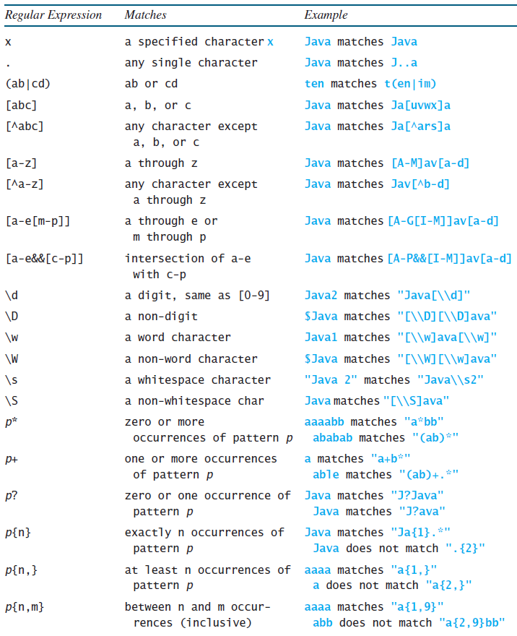
Regular Expression Syntax
Appendix H

Slide 27
Replacing and Splitting Strings
Appendix H

Slide 28
Examples
Appendix H
String s = "Java Java Java".replaceAll("v\\w", "wi") ;
String s = "Java Java Java".replaceFirst("v\\w", "wi") ;
String[] s = "Java1HTML2Perl".split("\\d");

Slide 29
More String

Slide 30
The String Type
The char type only represents one character. To represent a string of characters, use the data type called String. For example,
String message = "Welcome to Java";
String is actually a predefined class in the Java library just like the System class and Scanner class. The String type is not a primitive type. It is known as a reference type. Any Java class can be used as a reference type for a variable. Reference data types will be thoroughly discussed in Chapter 9, “Objects and Classes.” For the time being, you just need to know how to declare a String variable, how to assign a string to the variable, how to concatenate strings, and to perform simple operations for strings.

Slide 31
Simple Methods for String Objects

Slide 32
Simple Methods for String Objects
Strings are objects in Java. The methods in the preceding table can only be invoked from a specific string instance. For this reason, these methods are called instance methods. A non-instance method is called a static method. A static method can be invoked without using an object. All the methods defined in the Math class are static methods. They are not tied to a specific object instance. The syntax to invoke an instance method is
referenceVariable.methodName(arguments).

Slide 33
Getting String Length
String message = "Welcome to Java";
System.out.println("The length of " + message + " is "
+ message.length());

Slide 34
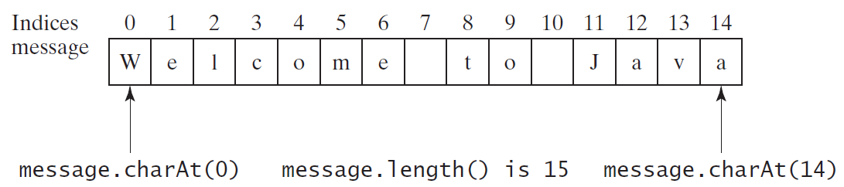
Getting Characters from a String
String message = "Welcome to Java";
System.out.println("The first character in message is "
+ message.charAt(0));

Slide 35
Converting Strings
"Welcome".toLowerCase() returns a new string, welcome.
"Welcome".toUpperCase() returns a new string, WELCOME.
" Welcome ".trim() returns a new string, Welcome.

Slide 36
String Concatenation
String s3 = s1.concat(s2); or String s3 = s1 + s2;
// Three strings are concatenated
String message = "Welcome " + "to " + "Java";
// String Chapter is concatenated with number 2
String s = "Chapter" + 2; // s becomes Chapter2
// String Supplement is concatenated with character B
String s1 = "Supplement" + 'B'; // s1 becomes SupplementB

Slide 37
Reading a String from the Console
Scanner input = new Scanner(System.in);
System.out.print("Enter three words separated by spaces: ");
String s1 = input.next();
String s2 = input.next();
String s3 = input.next();
System.out.println("s1 is " + s1);
System.out.println("s2 is " + s2);
System.out.println("s3 is " + s3);

Slide 38
Reading a Character from the Console
Scanner input = new Scanner(System.in);
System.out.print("Enter a character: ");
String s = input.nextLine();
char ch = s.charAt(0);
System.out.println("The character entered is " + ch);

Slide 39
Comparing Strings
OrderTwoCities
Run

Slide 40
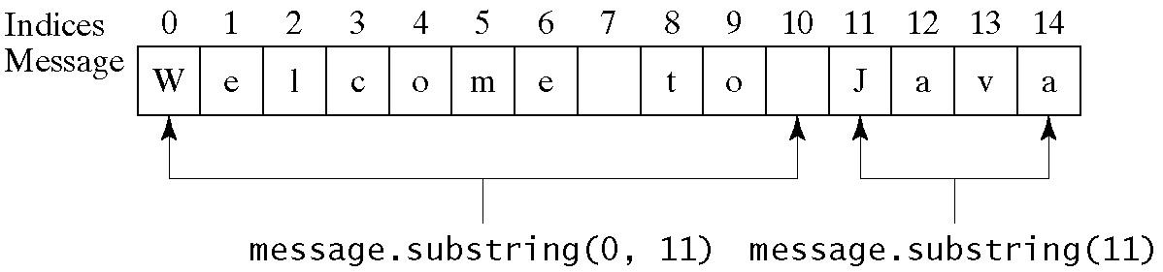
Obtaining Substrings

Slide 41
Finding a Character or a Substring in a String

Slide 42
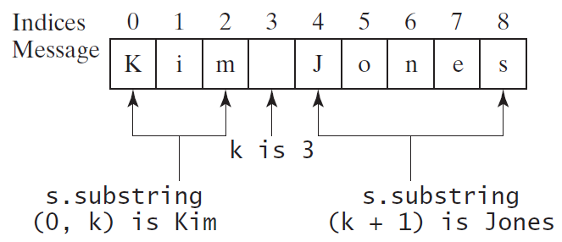
Finding a Character or a Substring in a String
int k = s.indexOf(' ');
String firstName = s.substring(0, k);
String lastName = s.substring(k + 1);

Slide 43
Conversion between Strings and Numbers
int intValue = Integer.parseInt(intString);
double doubleValue = Double.parseDouble(doubleString);
String s = number + "";

Slide 44
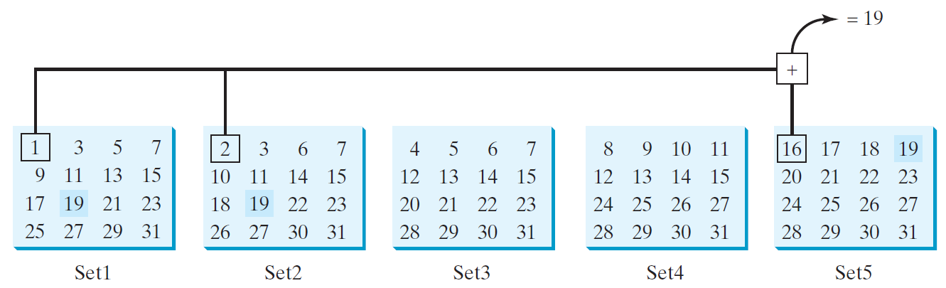
Problem: Guessing Birthday
The program can guess your birth date. Run to see how it works.
GuessBirthday
Run

Slide 45
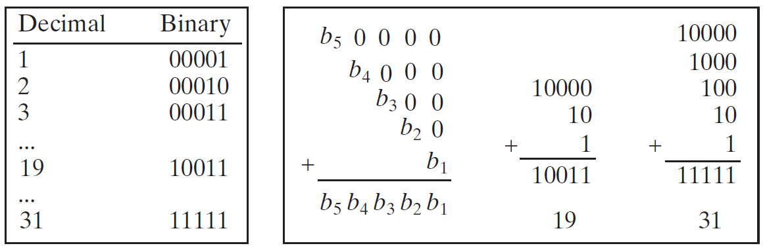
Mathematics Basis for the Game
19 is 10011 in binary. 7 is 111 in binary. 23 is 11101 in binary

Slide 46
Case Study: Converting a Hexadecimal Digit to a Decimal Value
Write a program that converts a hexadecimal digit into a decimal value.
HexDigit2Dec
Run

Slide 47
Case Study: Revising the Lottery Program Using Strings
A problem can be solved using many different approaches. This section rewrites the lottery program in Listing 3.7 using strings. Using strings simplifies this program.
LotteryUsingStrings
Run

Slide 48
Formatting Output
Use the printf statement.
System.out.printf(format, items);
Where format is a string that may consist of substrings and format specifiers. A format specifier specifies how an item should be displayed. An item may be a numeric value, character, boolean value, or a string. Each specifier begins with a percent sign.

Slide 49
Frequently-Used Specifiers
Specifier Output Example
%b a boolean value true or false
%c a character 'a'
%d a decimal integer 200
%f a floating-point number 45.460000
%e a number in standard scientific notation 4.556000e+01
%s a string "Java is cool"

Slide 50
FormatDemo
The example gives a program that uses printf to display a table.
FormatDemo
Run

